Slide 1
Big Data and AI Strategies
—Machine Learning and Alternative Data Approach to Investing
报告人：罗衍潮
2017.12

Slide 2
内容简介
INTRODUCTION AND OVERVIEW
目录
CONTENTS
BIG AND ALTERNATIVE DATA
MACHINE LEARNING METHODS
NEXT

Slide 3
01
内容简介-1
正在发生的变化：
1）参与者采用量化投资成增长趋势
2）方法：Risk Premia（ 风险 溢价）、算法交易（ algorithmic trading ）、 merging of fundamental and quantitative investment styles
各种数据集、机器学习与人工智能。
Over the past few years, we have witnessed profound changes in the marketplace with participants increasingly adopting quantitative investing techniques. These include Risk Premia investing, algorithmic trading, merging of fundamental and
quantitative investment styles, consumption of increasing amounts and differentiated types of data, and adoption of new
methods of analysis such as those based on Machine Learning and Artificial Intelligence.

Slide 4
01
内容简介-2
1）增长趋势 指数增长；2）基于大数据投资框架完全改变商业投资策略；3）有观望者；
In fact, over the past year, the exponential increase of the amount and types of data available to investors prompted some to completely change their business strategy and adopt a ‘Big Data’ investment framework. Other investors may be unsure on how to assess the relevance of Big Data and Machine Learning, how much to invest in it, and many are still paralyzed（麻痹的）in the face of what is also called the ‘Fourth Industrial Revolution’.
2 本报告：机器学习和大数据框架投资。包括：1) 各种数据；2）机器学习对各种数据的分析方法
In this report we aim to provide a framework for Machine Learning and Big Data investing. This includes an overview of types of alternative data(另类数据), and Machine Learning methods to analyze them.

Slide 5
01
内容简介-3
1）数据集是交易策略的核心；给出数据集分类与类型；2）评估数据与不同投资者相关性。
Datasets are at the core of any trading strategy. For this reason, we first classify and analyze the types of alternative datasets. We assess the relevance of various datasets for different types of investors and illustrate the use of Big Data in trading strategies.
数据来源：Datasets covered include 1）data generated by individuals (e.g. social media)人的交互数据, 2）data generated by business processes (e.g. commercial transactions) 业务流程数据 and 3）data generated by machines (e.g. satellite image data). 传感器生成的数据
机器学习方法和大数分析工具。
After focusing on Datasets, we explain and evaluate different Machine Learning methods which are necessary tools to analyze Big Data.

Slide 6
01
内容简介-4
方法有：
These methods include
1）Supervised Machine Learning（有监督学习）: regressions, classifications;
2）Unsupervised Machine Learning（无监督学习）: clustering, factor analyses;
3）Deep and Reinforcement Learning（深度强化学习）
提供：
We provide 1）theoretical, 2）practical (e.g. codes) and investment
3）examples for different Machine Learning methods, and 4）compare their relative performance.
最后：大数据与AI的路线图
The last part of the report is a handbook of over 500 alternative data and technology providers, which can be used as a rough roadmap to the Big Data
and Artificial Intelligence landscape.

Slide 7
01
内容简介-5
hope
We hope this guide will be educative for investors new to the concept of Big Data and Machine Learning, and provide new insights and perspectives（观点） to those who already practice it. Such as those based on Machine Learning and Artificial Intelligence.
希望让投资者了解机器学习和人工智能新的投资理念

Slide 8
01
内容简介-6-目录1
I: INTRODUCTION AND OVERVIEW
1.1 Big Data and Machine Learning
1.2 Classification of Alternative Data Sets Classification of Machine Learning Techniques
1.3 Positioning within the Big Data Landscape(大数据的定位)
II: BIG AND ALTERNATIVE DATA
2.1 Overview of Alternative Data
2.2 Data from Individual Activity
2.3 Data from Business Processes
2.4 Data from Sensors

Slide 9
01
内容简介-6-目录2
III: MACHINE LEARNING METHODS
3.1 Overview of Machine Learning Methods
3.2 Supervised Learning : Regressions
3.3 Supervised Learning : Classifications
3.4 Unsupervised Learning: Clustering and Factor Analyses
3.5 Deep and Reinforcement Learning
3.6 Comparison of Machine Learning Algorithms

Slide 10
01
内容简介-6-目录3
IV: HANDBOOK OF ALTERNATIVE DATA
4.1 Table of contents of data providers
A. Data from Individual Activity
B. Data from Business Processes
C. Data from Sensors
D. Data Aggregators
E. Technology Solutions.

Slide 11
01
内容简介-6-目录4
5 APPENDIX
5.1 Techniques for Data Collection from Websites
5.2 Packages and Codes for Machine Learning
5.3 Mathematical Appendices
5.4 References
5.5 Glossary

Slide 12
内容简介
INTRODUCTION AND OVERVIEW
目录
CONTENTS
BIG AND ALTERNATIVE DATA
MACHINE LEARNING METHODS
NEXT

Slide 13
02
INTRODUCTION AND OVERVIEW-1-Big Data and Machine Learning ‘revolution’
Most records and observations nowadays are captured electronically by devices connected to the internet. This, in principle, allows investors to access a broad range of market relevant data in real time. For instance, online prices of millions of items can be used to assess inflation(通货膨胀), the number of customers visiting a store and transacting can give real time sales estimates, and satellite imaging can assess agricultural yields or activity of oil rigs.
Historically, similar data were only available at low frequency (e.g. monthly CPI, weekly rig counts, USDA crop reports美国农业部作物报告, retail sales reports and quarterly earnings, etc.). Given the amount of data that is available, a skilled quantitative investor can nowadays in theory have near real time macro or company specific data not available from traditional data sources. In practice, useful data are not readily available and one needs to purchase, organize and analyze alternative datasets in order to extract tradeable signals. Analysis of large or unstructured datasets is often done with the use of Machine Learning . Successful application of Machine Learning techniques requires some theoretical knowledge and a lot of practical experience in designing quantitative strategies.

Slide 14
02
INTRODUCTION AND OVERVIEW
Big Data and Machine Learning ‘revolution’:
Datasets and Methodologies: There are two main components of a Big Data investment approach: 1)acquiring and understanding the data 2) and using appropriate technologies and methods to analyze those data.
Fear of Big Data and Artificial Intelligence（恐慌）: While many traditional investors don’t have a good understanding of the types of data available, and feel uneasy about adopting Machine Learning methods.
How will Big Data and Machine Learning change the investment landscape?(影响) We think the change will be profound. As more investors adopt alternative datasets, the market will start reacting faster and will increasingly anticipate traditional or ‘old’ data sources (e.g. quarterly corporate earnings, low frequency macroeconomic data, etc.).
Potential Pitfalls of Big Data and Machine Learning（缺陷）: The transition to a Big Data framework will not be without setbacks. Certain types of data may lead into blind alleys - datasets that don’t contain alpha, signals that have too little investment capacity, decay quickly, or are simply too expensive to purchase.

Slide 15
内容简介
INTRODUCTION AND OVERVIEW
目录
CONTENTS
BIG AND ALTERNATIVE DATA
MACHINE LEARNING METHODS
NEXT

Slide 16
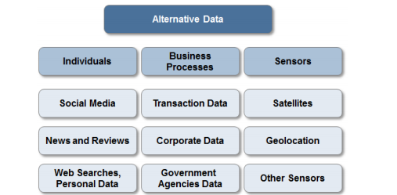
03
BIG AND ALTERNATIVE DATA
we classified alternative data sets based on how they were generated: by1） online activity of individuals 2)business processes 3)sensors.

Slide 17
03
BIG AND ALTERNATIVE DATA——Data from Individual Activity
This type of alternative data is a result of the online activity of individuals.
We further classify this data into the three subcategories:
1.social media data (e.g. Twitter, LinkedIn, blogs)
2.data from specialized sites (e.g. news media, product reviews) 3.web searches and volunteered personal data (e.g. Google search, email receipts).

Slide 18
03
BIG AND ALTERNATIVE DATA——Data from Individual Activity
Social media sentiment analysis (情感分析)is a fairly popular type of alternative data. Twitter is the most common source,
followed by various news vendors and blog sites. We can conceptually understand sentiment analysis of written text by breaking it down in a four step process:
• Named entity extraction（提取实体）
• Theme and category extraction（抽取主题和类别）
• Intention and Sentiment(用NLP技术提取说话的意图和情感)
• Relevance and Influence（相关性和影响力）

Slide 19
03
Data from Individual Activity——Case Study
• Twitter sentiment data to trade the broad equity market (iSentium)
iSentium提供实时Twitter的情绪时间序列数据。它给投资者提供了一个判断新闻、twitter或其他媒体信息是否会给市场带来冲击的搜索引擎。iSentium数据的回馈测试表明社交媒体情绪分析可以作为判断短期市场波动的指标。
• News sentiment data to trade bonds, equities and currencies (RavenPack)
RavenPack该公司的产品允许客户通过系统地将公共信息的影响纳入其模型或工作流中，以提高回报、降低风险和提高效率。

Slide 20
03
Data from Individual Activity——Case Study
Using Twitter Sentiment to trade S&P 500 (标准普尔500指数)
iSentium provides real-time sentiment time series based on Twitter messages. It is effectively a sentiment search engine
which can provide investors with a way to judge the potential market impact of a tweet, a news article, or other social media
activities. Backtests of iSentium Daily Directional Indicators (DDI) indicate that social media sentiment can be used as a predictor for short term market moves.

Slide 21
03
Case Study——iSentium
J.P. Morgan has constructed the JPUSISEN Index that takes intraday long or short positions in the S&P 500 Index, based on a daily directional indicator provided by iSentium.
Construction of iSentium Daily Directional Indicator：
1. The universe is limited to the 100 stocks which are most representative of the S&P 500, filtered using tweet volume and realized volatility measures.
2. Tweets are assigned a sentiment score using a patented NLP algorithm.自然语言处理
3. By aggregating tweet scores, a sentiment level is produced per minute between 8:30 AM and 4:30 PM every day.Sentiment for the day is aggregated using an exponentially weighted moving average over the past ten days.使用指数加权移动平均线汇总当天的情绪
4. S&P 500 returns are forecasted using a linear regression（线性回归） over the sentiment scores for the past two days, with betas evolved via a Kalman filter（卡尔曼滤波）.

Slide 22
03
Case Study——Ravenpack
Using News Sentiment to trade Bonds, Currencies and Commodities (Ravenpack)货币交易、主权债券和商品
RavenPack analyzes unstructured datasets to produce structured and granular indicators of relevance to investment professionals. Unstructured data include
1.premium newswires （高级新闻线索）
2.regulatory news providers（监管新闻提供者）
3.press releases and over 19,000 web publications（新闻稿和网络出版物）
we can calculated daily sentiment scores（每日情绪分数） for different assets of interest from RavenPack’s raw newsfeed（原始新闻源中）.

Slide 23
03
Case Study——Ravenpack
RavenPack provides 50 data fields for each event. We analyzed data since 2005 for each asset of interest.
1. Step One: isolate all unique events on a given day specific to a certain “ENTITY_NAME”（确定实体名称）. Entity name was set equal to the currency, commodity or country name. We set a cutoff time of 4 PM EST to reflect NY market close.
2. Step Two: RavenPack provides a field called “RELEVANCE”（相关性）, which is an integer score between 0 and 100. A higher value indicates that the mention of the entity is more integral to the underlying news story. We used RELEVANCE as a cut-off filter, ignoring stories with a value < 75.忽略价值<75的新闻事件
3. Step Three: RavenPack provides a field called “EVENT_SENTIMENT_SCORE”（情绪评分字段） or ESS. It is a granular score between -1.00 and +1.00 that represents the news sentiment for a given entity. The average of ESS for all filtered events was designated as the sentiment value for the day. （粒度分数，代表实体的新闻情绪，为当天所有新闻进行细粒度评分）

Slide 24
03
BIG AND ALTERNATIVE DATA——Data from Business Processes
Data generated by Business Processes（业务流程数据） includes data made available by
1.public agencies (e.g. federal and state governments)
（公共机构（政府）提供的数据）
2.commercial transactions (including e-commerce and credit card spending, exchange transaction data)
（商业交易数据（电子商务、信用卡支出、交易所数据））
3.data from other private agencies (e.g. industry specific supply chain data).
（私营机构数据（特定的供应链数据））

Slide 25
03
Data from Business Processes——Case Study
Using Email Receipt Data to trade US Equities (Eagle-Alpha)
（电子邮件收据数据交易美国股票）
we analyze a trading strategy based on email receipt data provided by Eagle Alpha which tracks transaction data representing 80% of all online purchases.
Eagle Alpha provides a variety of services across the spectrum of alternative data,including: 1.data sourcing（数据源）
2.bespoke projects（定制项目）
3.teach-ins and analytical services. （教学和分析服务）

Slide 26
03
Data from Business Processes——Case Study
We have analyzed a dataset of email receipts for 97 companies. 36 of these were private companies, and 61 public, 31 of which were S&P 500 constituents. Taking liquidity(流动性) into consideration, we decided to test trading signals for the S&P 50 companies only.
1. analyzed three time series: 1）the dollar spend 2）number of orders 3）number of buyers. While number of orders and number of buyers are highly correlated (~99%), dollar spend is not highly correlated with number of buyers/orders (~25%).
2. aggregated the daily spend/order/buyer data into a weekly score and calculated week-over-week percentage change for each.
3. After winsorizing to 5th-95th percentile, we tested both the level and z-score as signals. （极值调整，水平和Z值作为信号）
4.Based on a cross-sectional comparison, we went long the top 5 stocks and short the bottom 5 stocks.

Slide 27
03
BIG AND ALTERNATIVE DATA——Data from Sensors
We categorized data generated by sensors into three groups:
1.satellite data （卫星数据）
2.geolocation data（地理位置数据）
3.data generated by other sensors.（其他传感器生成的数据）

Slide 28
03
Data from Sensors ——Case Study
Using Cellular Location to Estimate Retail Sales (Advan)
使用蜂窝位置估计零售销售
Advan Research estimates customer traffic （客户流量）at physical store locations by tracking location of smart phones. Data is collected via apps that install geo-location codes on cell phones with the users’ explicit consent. Following the installations, these apps track location using multiple channels (like WiFi, Bluetooth and cellular signal(蜂窝信号)) to improve accuracy.
提高手机上的地理位置码的精度

Slide 29
03
Data from Sensors ——Case Study
Advan geolocation data can be used to proxy the top-line revenue of publicly traded firms. Spanning 30% of the US population, the company sees approximately 25 million devices/per day, 60mm/per month, analyzes >3B data points per day and computes traffic for 1,033,050 locations of which 498,749 have been manually reviewed. The data can be mapped to revenues of 80 different S&P 500 stocks23 (381 stocks in total) from retail, big box stores, supermarkets, hotels, hospitals,restaurants, movie theaters, amusement parks, dollar stores and fast food companies. In order to independently assess the predictive power of geolocation signals, we analyzed a sample dataset from Advan.
众多的数据集不好评估定位信号预测能力，转而分析Advan公司提供的样本集

Slide 30
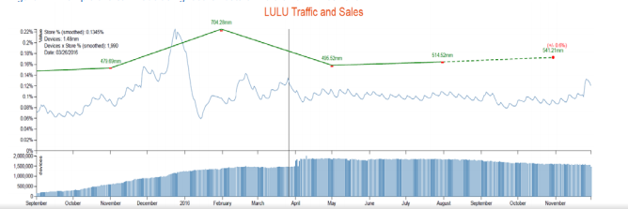
03
Data from Sensors ——Case Study
Example:
On Dec 2, 2016 Advan Research noted QTD traffic at Lululemon (LULU) locations were up 7%. This motivated them to predict LULU sales to beat the street consensus; a claim that was validated on Dec 7th, when the firm announced sales results. This sales surprise boosted the stock from $58 to $67 within a day.

Slide 31
03
Data from Sensors ——Case Study
Satellite Imagery of Parking Lots and Trading Retail Stocks (RS Metrics)
停车场的卫星图像和零售股票指标（RS指标）
RS Metrics analyzes geospatial data drawn from various sources including satellites, drones and airplanes. RS Metrics provides signals, predictive analytics, alerts and end-user applications.
RS指标提供信号、预测分析、警报和最终用户应用程序。
RS Metrics provided us with their buy-sell indicators for a set of retail stocks, alongside with detailed signal construction methodology.
RS指标为我们提供了零售股票的买入卖出指标

Slide 32
03
Data from Sensors ——Case Study
Our strategy :
involved trading individual stocks based on the buy/sell indicators from traffic. Positions were taken and held until the next signal. We concentrated on names in the S&P 500 with sufficiently long history of the signal; results for other stocks in the basket are also provided for completeness.
The strategy for each stock was as follows:
1.A position starts from the date on which a signal (1, 0, -1) is produced by RS Metrics and the position is held until a change in the signal.
2.A signal of 1 triggers a long stock / short US Retail index benchmark position; -1 triggers a short stock and long US Retail index position. For a 0 signal, we are invested in cash.

Slide 33
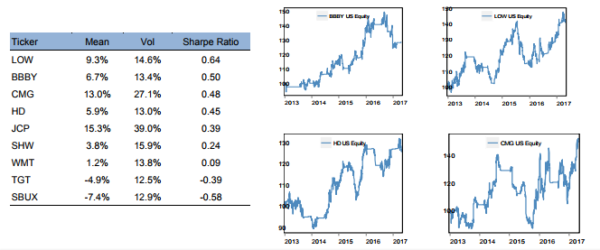
03
Data from Sensors ——Case Study
Example: Performance of strategy using RS Metrics signal (selected stocks in the S&P 500 with history since 2013)采用RS指标信号策略 标普500精选股
Results were positive for most of the S&P 500 stocks for which data was available since Jan 1, 2013. There are a total of 15 stocks which are in the S&P 500, and only 9 out of them have history since 2013.

Slide 34
内容简介
INTRODUCTION AND OVERVIEW
目录
CONTENTS
BIG AND ALTERNATIVE DATA
MACHINE LEARNING METHODS
NEXT

Slide 35
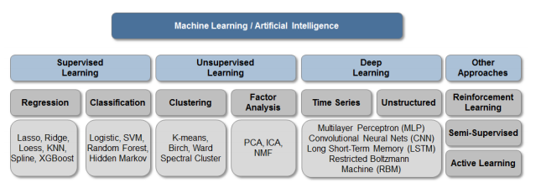
04
MACHINE LEARNING METHODS
Each class of Machine Learning methods:1）Supervised Learning 有监督学习2）Unsupervised Learning 无监督学习 3）Deep Learning 深度学习4） Machine Learning机器学习approaches (e.g. Reinforcement learning)

Slide 36
04
MACHINE LEARNING METHODS
Machine Learning is a hybrid field（交叉领域） combining concepts and research from two fields:
1.Statistics (Mathematics) 数学统计
2.Computer Science. 计算机科学
Related to its origins, Machine Learning can roughly be divided into two categories: 1.Classical Machine 经典机器学习
2.Learning and Deep Learning. 学习与深度学习

Slide 37
04
MACHINE LEARNING METHODS——Classical Machine Learning
Supervised and Unsupervised Learning are often called Classical Machine Learning.
A Machine Learning algorithm calibrates （校准）its parameters by using data fed by an analyst i.e. the algorithm learns (fits) the model and improves this model as more and more data are collected. The term “supervised learning” arises from noting that the analyst guides (and hence supervises) the computer’s algorithm in its calibration of parameters by giving it a training set with clearly labelled input variables and clearly labelled output or predicted variables.

Slide 38
04
MACHINE LEARNING METHODS——Deep Learning
Deep Learning is behind almost all of the prominent（著名的） accomplishments of Machine Learning in the past decade. Image recognition, speech recognition, language translation and even self-driving cars all rely on the new Deep Learning algorithms. Unlike supervised and unsupervised learning, relatively little is known about applications of Deep Learning to trading. Deep Learning is certainly used to process Big Data: satellite images（卫星图像）, natural language processing（NLP自然语言处理）, etc. Most investment managers will reap benefit of Deep Learning, without actually implementing the methods.

Slide 39
04
MACHINE LEARNING METHODS
There is no one Machine Learning model that will be the best choice for all investment research projects. For this reason quantitative analysts should be familiar with a broad range of Machine Learning models and their application (in addition to understanding methods of analysis, one needs to understand the dataset and financial assets used to trade the data signal).
Step 1: tackle a dataset is to make an educated guess on which method of analysis is expected to yield the best results.
Step 2: specify the number of model parameters and their values which is often related to the tradeoff between ‘variance and bias’.

Slide 40
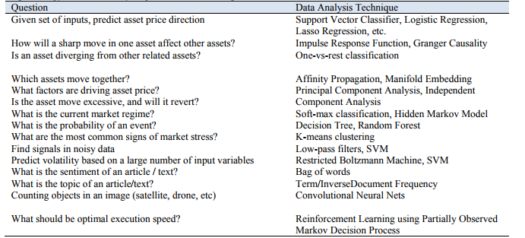
04
MACHINE LEARNING METHODS——Selecting the ‘right’ Machine Learning Model
The table below illustrates this by linking typical tasks and frequently used methods.

Slide 41
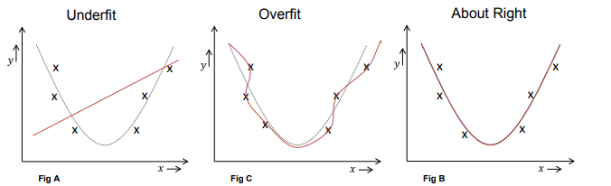
04
MACHINE LEARNING METHODS—— tradeoff between ‘variance and bias’
To illustrate the ‘variance and bias’ tradeoff, consider the three graphs below.

Slide 42
04
MACHINE LEARNING METHODS—— tradeoff between ‘variance and bias’
For these graphs, we first generated data for a simple quadratic function plus some random noise (e.g. ). In finance these quadratic functions may be encounters in e.g. response of USD（美元） to level of economic growth, or market volatility’s response to level of inflation. We can fit quadratic data with a linear, quadratic and a high order polynomial （多项的）(e.g. 10th order).
It is clear that a linear fit ‘under-fit’, introducing large historical errors also known as ‘bias’ (of predicted versus observed data points). It is clear that a linear model is too simple and inadequate to explain the data points. Use of a High order polynomial (figure in the middle), resulted in very low error on historical data (low bias) but this model is clearly ‘overfitting’ the data. Over-fitting implies that new data points will likely not be predicted with same degree of accuracy, and our historical estimation of error may be misleading. In learning theory terminology, we have higher variance of the model (but lower historical ‘bias’).

Slide 43
04
MACHINE LEARNING METHODS—— tradeoff between ‘variance and bias’
In mathematical terms, we can formalize Variance-Bias tradeoff as follows. We are trying to estimate functional relationship between inputs (x) and output (y) in the presence of random noise
Variables (x) are some set of signals, and predicted variable (y) is often future return of asset. Goal of Machine Learning is to come up with a model function that mimic（模仿） function y and is used to predict future asset returns (y). Error in our estimation (this error will be detrimental to our forecast and hence PnL（Profit and Loss的缩写，损益） of a strategy) is given as.

Slide 44
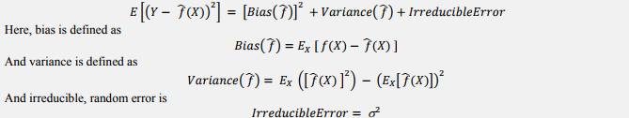
04
MACHINE LEARNING METHODS—— tradeoff between ‘variance and bias’

Slide 45
内容简介
INTRODUCTION AND OVERVIEW
目录
CONTENTS
BIG AND ALTERNATIVE DATA
MACHINE LEARNING METHODS
NEXT

Slide 46
05
NEXT：MACHINE LEARNING METHODS
Next we will present methods of Supervised Learning. From the category of: 1）Regressions (and related) Models：try to predict output variables based on a number of input variables.
2）Classification models : attempt to group or classify output into categories.
Regressions
• Penalized Regression Techniques: Lasso, Ridge, and Elastic Net
• Non-Parametric Regression: Loess and K-Nearest Neighbor
• Dynamical Systems: Kalman Filtering
• Extreme Gradient Boosting
Classification
• Logistic Regression
• Support Vector Machines
• Decision Trees and Random Forests
• Hidden Markov Model

Slide 47
05
NEXT:MACHINE LEARNING METHODS——Penalized Regression Techniques
Penalized regression techniques like Lasso (also, spelt as LASSO) and Ridge are simple modifications of ordinary linear regression aimed at creating a more robust output model in the presence of a large number of potentially correlated
variables. When the number of input features is large or when the input features are correlated, classical linear regression has a tendency to overfit and yield spurious coefficients. LASSO, Ridge, and Elastic Net regressions are also examples of‘regularization’ – a technique in Machine Learning that is expected to reduce the out-of-sample forecasting errors .

Slide 48

05
NEXT：MACHINE LEARNING METHODS————Penalized Regression Techniques
Take example
ordinary linear regression:
To find the ‘betas’ β 0, β1...linear regression minimizes the historical error (square of error) between actual observations of variable ‘y’, and predicted (or model) values of the variable. This is the reason the method is also called least-squares (since it minimizes the square of errors):

Slide 49
05
NEXT:MACHINE LEARNING METHODS——Penalized Regression Techniques
Instead of minimizing the least-squares objective, we can modify it by adding a penalty term that reflects our aversion towards complex models with large ‘betas’. If we change the objective to include a penalty term equal to the absolute value of the beta coefficients, i.e.

Slide 50
05
NEXT:MACHINE LEARNING METHODS——Penalized Regression Techniques
Example of Penalized Regression Approach in a Multi Asset Trend Following Strategy
We illustrate an application of Lasso by estimating the 1-day returns of assets in a cross-asset momentum model. For more background on trend following strategies see our CTA primer. We attempt to predict the returns of 4 assets: S&P 500, 7-10Y Treasury Bond Index, US dollar (DXY) and Gold. For predictor variables, we choose lagged 1M, 3M, 6M and 12M returns of these same 4 assets, yielding a total of 16 variables. To calibrate the model, we used a rolling window of 500 trading days (~2y); re-calibration was performed once every 3 months. The model was used to predict the next day’s return. If the next day predicted return was positive, we went long the asset, otherwise we shorted it. Prior to regression, all inputs were standardized to avoid the problem of input features being of different scales. Performance of this momentum strategy is shown in tables below for each of the assets. Note that each of the momentum strategies outperformed a long only position in their respective asset.

Slide 51
05
NEXT:MACHINE LEARNING METHODS——Non-Parametric Regression
In parametric techniques, the model is described by a set of parameters such as linear regression beta (that is estimated from historical data). In non-parametric techniques, we do calibrate parameters of a model, but directly identify similar historical instances, and assume the behavior will be the same. Given a new datapoint, we search through historical data and identify a number ‘K’ of similar instances that we call “nearest neighbors” ‘NN’ (hence name K-NN). Then we then make predictions by averaging historical outcomes for these “nearest neighbors”.

Slide 52
05
NEXT:MACHINE LEARNING METHODS——Non-Parametric Regression
Two examples of non-parametric regressions are:
1. K-Nearest Neighbor (KNN)33 rule: Once we have located K nearest neighbors, we can average the output variabley for this subset and use that as our prediction.
2.LOESS: Using data for the K nearest neighbors, for each new point we fit a linear regression based on the Knearest neighbors (subset of historical data), and predict the output using those coefficients. This is called LOESS or localized linear regression.

Slide 53
05
NEXT:MACHINE LEARNING METHODS——Dynamical Systems
Dynamical Systems: Kalman Filtering
The Kalman Filter (Kalman, 1960) is a technique that combines a series of observations, in the presence of uncertainty, in order to estimate and forecast parameters of an evolving system. The algorithm usually works in two-steps:
1.one comes with an estimate of the current state and an estimated error.
2.incorporated to obtain a new forecast (by properly weighting the previous estimate and error, and new observation and error).

Slide 54
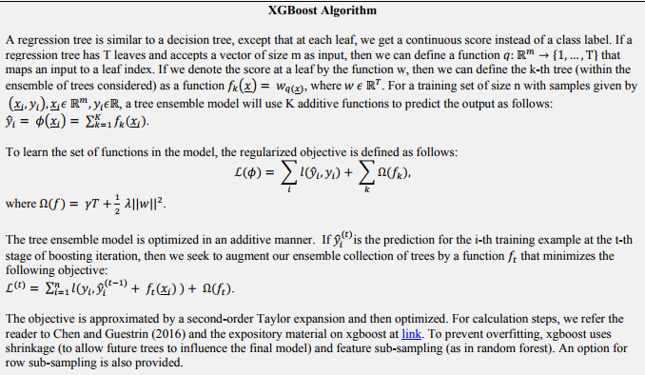
05
NEXT:MACHINE LEARNING METHODS——Extreme Gradient Boosting

Slide 55
05
NEXT:MACHINE LEARNING METHODS——Classifications
Classification methods of supervised learning have a goal of classifying observations into distinct categories.
In this section, we cover the following classification algorithms:
1.logistic regression
2.Support Vector Machines (SVM)
3.decision trees and random forests
4.Hidden Markov Models.

Slide 56
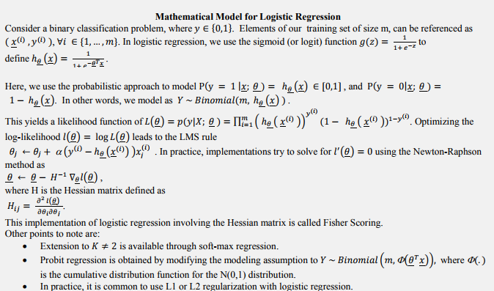
05
NEXT:MACHINE LEARNING METHODS—— Logistic Regression

Slide 57
05
NEXT:MACHINE LEARNING METHODS——Support Vector Machines
Support Vector Machines (SVM): are based on fitting a linear classifier to the dataset after enhancing it with new derived features (like squares/cubes of input columns and interaction terms). We provide an informal explanation of the method below. Most practitioners will use ready made codes (e.g. inR/Python) to implement the method and will not care about theoretical considerations.

Slide 58
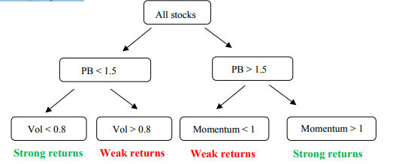
05
NEXT:MACHINE LEARNING METHODS——Decision Trees and Random Forests
Decision trees: are one of the simplest non-linear models that can be used to classify outcomes.
Random forests: improve upon this idea by averaging the output of many decision trees.
Example of decision tree to classify whether future stock returns are good or poor. In each node, we split the data into two subsets depending on the value of the splitting variable.

Slide 59
05
NEXT:MACHINE LEARNING METHODS——Hidden Markov Models
Hidden Markov Models (HMM):are similar to the Kalman filter (i.e. similar to other State Space models) where the the probability of the next state only depends on the current state (i.e. hidden state follows a discrete Markov process). HMMs are useful statistical models because in many real world problems, we are interested in identifying some events which are not directly observable (e.g.are we in an up-trending or down-trending market?), but these events can be inferred from other variables that we can observe (e.g. market returns, market volatility, etc.).

Slide 60
05
NEXT:MACHINE LEARNING METHODS——Unsupervised Learning
Unsupervised learning algorithms examine the dataset and identify relationships between variables and their common drivers. In unsupervised learning the machine is simply given the entire set of returns of assets and it does not have a notion of what are independent and what are the dependent variables. Methods of unsupervised learning are often categorized as
1. Clustering
2. Factor analyses.

Slide 61
05
NEXT:MACHINE LEARNING METHODS——Clustering
Clustering involves splitting a dataset into smaller groups based on some notion of similarity. In finance that may involve identifying historical regimes such as high/low volatility regime, rising/falling rates regime, rising/falling inflation regime, etc. Correctly identifying the regime can in turn be of high importance for allocation
between different assets and risk premia.
we evaluate and compare several clustering algorithms:
1.K-Means
2.Ward, Birch
3. Affinity, Spectral
4.MiniBatch
5.Aggregate
6.HDSBscan
7. ICA.

Slide 62
05
NEXT:MACHINE LEARNING METHODS——Clustering
K-means – Simplest clustering algorithm that starts by initially marking random points as exemplars. It iteratively does a two-step calculation:
1.it maps points to closest exemplar;
2.it redefines the exemplar as the mean of the points mapped to it. It locates a fixed number of clusters (which is assigned to two in our code example that follows).
Ward – A hierarchical clustering technique that is similar to K-means, except that it uses a decision tree to cluster points.
Birch – A hierarchical clustering technique designed for very large databases. It can incrementally cluster streaming data;hence in many cases, it can cluster with a single pass over the data set.

Slide 63
05
NEXT:MACHINE LEARNING METHODS——Clustering
Affinity Propagation – Algorithm involves passing of ‘soft’ information that treats every point as a possible exemplar and allows for the possibility of every point being included in a cluster around it. The algorithm is known to be good for finding
a large number of small clusters. The number of clusters chosen can be indirectly influenced via a ‘preference’ parameter;we have used the default settings within the Python sklearn library.
Spectral Clustering – Like affinity propagation, it passes messages between points, but does not identify the exemplar of each cluster. It needs to be told the number of clusters to locate (we have specified two). This is understandable, since the
algorithm computes an affinity matrix between samples, embeds into a low-dimensional space and then runs K-means to locate the clusters. This is known to work well for a small number of clusters.

Slide 64
05
NEXT:MACHINE LEARNING METHODS——Clustering
Mini-Batch – To reduce processing time, mini-batches of data are processed with a k-means algorithm. However unlike kmeans the cluster centroids are only updated with each new batch, rather than each new point. Mini-Batch typically converges faster than K-Means, but the quality can be slightly lower.
HDBSCAN – Hierarchical Density-Based Spatial Clustering of Applications with Noise is a ‘soft’ clustering algorithm where points are assigned to clusters with a probability and outliers are excluded. HDBSCAN runs multiple DBScans over the data seeking the highest cluster stability over various parameters.
ICA – Independent Component Analysis is similar to Principal Component Analysis (PCA) but is better at distinguishing non-Gaussian signals. While these techniques are typically used in factor extraction and dimension reduction, we have used
the exposures to these common (hidden) factors to form clusters to explore the potential of these components to identify similarity between members’ returns.

Slide 65
05
NEXT:MACHINE LEARNING METHODS——Factor Analysis
Factor Analysis through PCA
Factor analyses aim to identify the main drivers of the data or identify the best representation of the data.
Principal Component Analysis (PCA) is a statistical tool for dimensionality reduction that continues to find use in Big Data analysis. Given market data, PCA can decompose each time series into a linear combination of uncorrelated factors.Further, PCA can quantify the impact of each factor on the time series by calculating the proportion of the variance that is explained by any given factor. By plotting the PCA factors, we can visualize and estimate typical moves one can expect to see in a given market regime.

Slide 66
汇报完毕 感谢聆听

Slide 67
06
专业术语解释
Alternative Data另类数据
指的是传统上不被认为是金融数据的数据，但它却为投资者提供了市场洞察力。它往往是相当“原始”，这意味着投资者必须做数据挖掘或数据科学来提取洞察力。包括：
1.社会媒体情绪数据：反映来自社会媒体的投资者情绪的数据
2.科技数据：原始数据对作物产量，通过卫星或农场的传感器数据融合
3.消费者趋势：来自于观测机制的原始消费者数据，如卫星、无人驾驶飞机、监视摄像机。
S&P 500标准普尔500指数
标准·普尔500指数是由标准·普尔公司1957年开始编制的。它以1941年至1942年为基期，基期指数定为10，采用加权平均法进行计算，以股票上市量为权数，按基期进行加权计算。与道·琼斯工业平均股票指数相比，标准·普尔500指数具有采样面广、代表性强、精确度高、连续性好等特点，被普遍认为是一种理想的股票指数期货合约的标的。

Slide 68
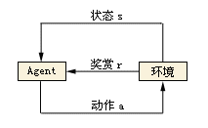
06
专业术语解释
强化学习：
强化学习是机器学习中的一个领域，强调如何基于环境而行动，以取得最大化的预期利益。其灵感来源于心理学中的行为主义理论，即有机体如何在环境给予的奖励或惩罚的刺激下，逐步形成对刺激的预期，产生能获得最大利益的习惯性行为。
在强化学习的世界里， 算法称之为Agent， 它与环境发生交互，Agent从环境中获取状态（state），并决定自己要做出的动作（action）.环境会根据自身的逻辑给Agent予以奖励（reward）。奖励有正向和反向之分。比如在游戏中，每击中一个敌人就是正向的奖励，掉血或者游戏结束就是反向的奖励。
返回

Slide 69
06
专业术语解释
另类数据：
只要可能影响投资决策但又不属于市场统计数据和公司财报这类传统信息的数据都称为“另类数据”。
返回

Slide 70
06
专业术语解释
RavenPack：
RavenPack is the leading big data analytics provider for financial services. Financial professionals rely on RavenPack for its speed and accuracy in analyzing large amounts of unstructured content. The company’s products allow clients to enhance returns, reduce risk and increase efficiency by systematically incorporating the effects of public information in their models or workflows. RavenPack’s clients include the most successful hedge funds, banks, and asset managers in the world.
返回

